Slide 1
Clickstream Data

Slide 2
Topics Covered
Clickstream Data:
Weblogs
Beacons
JavaScript Tags
Packet Sniffing
Outcomes data
Competitive data
Search Engine Data

Slide 3
There are four main ways of capturing clickstream data:
web logs
web beacons
JavaScript tags
and packet sniffing

Slide 4
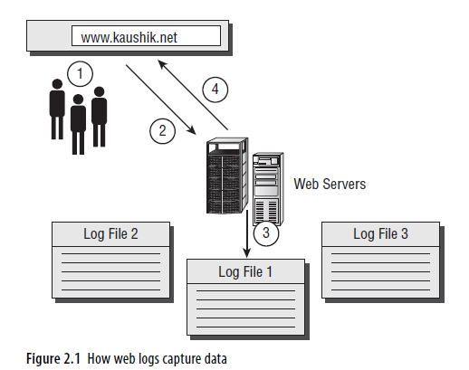
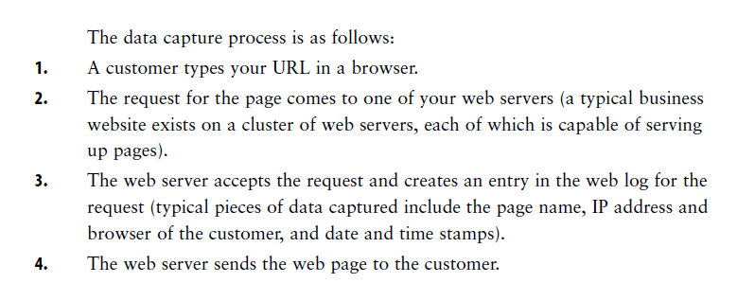
web logs

Slide 5
Benefits of Using Web Logs as Your Data Collection Mechanism
Web logs are perhaps the most easily accessible source of data. Every web server simply comes with mechanisms that collect the data and create web logs
There are many log file parsers now easily available for free
Web logs are the only data capture mechanism that will capture and store the visits and behavior of search engine robots on your website.
if you want to analyze visits by the Google, Microsoft Network (MSN), and Yahoo search engine robots to ensure that your website is being crawled and indexed correctly, you have to use web logs.
If you use web logs, you always own the data.

Slide 6
Concerns about Using Web Logs as Your Data Collection Mechanism
They are not optimally suited to capture business or marketing information.
If additional marketing and business information need to be captured, that capture requires a close collaboration with your IT team
If the web server is not setting cookies, identifying visitors with any degree of accuracy is very challenging.
when using logs, you have to be very careful and deliberate about applying the right filters to remove image requests, page errors, robot traffic, requests for Cascading Style Sheets (CSS) files, and so forth, in order to get accurate traffic trends and behavior
Page caching by ISPs and proxy servers could mean that some of your is invisible to you. With page caching common, your website pages (say, your home page, product pages, and so forth) are cached at the ISP or proxy servers. So when someone from that ISP’s network requests your home page, it is served from the ISP and not your web server.

Slide 7
Web Beacons
Web beacons were developed during a time when banners ruled the Web
A company would run banner ads across many websites, and often these would be similar banner ads. (how many people who saw the banner ads were clicking through.)
Web beacons usually are 1 ⋅ 1 pixel transparent images that are placed in web pages, within an img src HTML tag. The transparent images are usually hosted on a third-party server—different from the server that is hosting the web page.
The transparent image is requested when the email loads in your email reader, and data about the email view is sent back and recorded.
Typical data could include the fact that the email was read, by whom (email address), and any other parameters that might be appended at the end of the transparent image request embedded in the email.

Slide 8
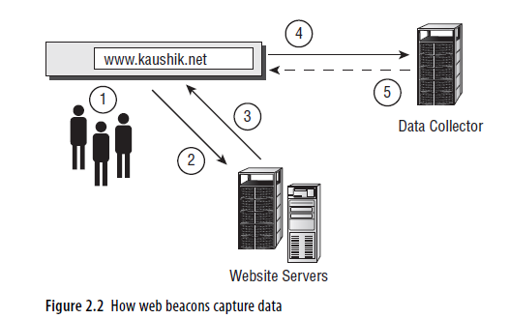
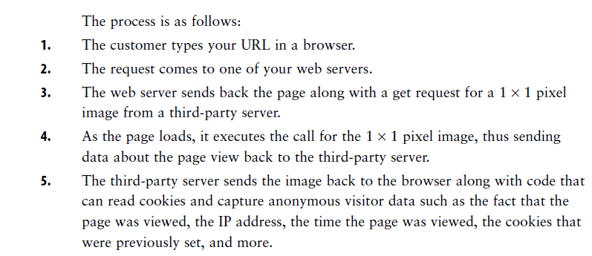

Slide 9
Benefits of Using Web Beacons as Your Data Collection Mechanism
Web beacons are easy to implement in most cases because they are just a couple of lines of code wrapped around an img src HTML tag request
You can optimize exactly what data the beacon collects (for example, just the page viewed, or time, or cookie values, or referrers)
when it comes to collecting data across multiple websites or domains. If you are a publisher who puts content on many sites, or if you are a company that has many sites in your own network, you can use beacons to easily collect and store data from all these sites on one server

Slide 10
Concerns about Using Web Beacons as Your Data Collection Mechanism
Beacons are most closely identified with advertising and advertising networks and therefore have a bit of a bad rap
If image requests are turned off in email programs, you can’t collect the data
Beacons are not as expansive and customizable as JavaScript tags
Beacons interact with third-party servers and for the most part set third-party cookies, Antispyware programs will also delete these third-party cookies, making it much harder to track

Slide 11
JavaScript Tags
JavaScript tagging allowed for more data to be collected more accurately and—very important—it ushered in new business models
Data serving was separated from data capture, hence reducing the reliance on corporate IT departments for various data capture requests
No longer was there a need for companies to host their own infrastructure to collect data, a team to process the data, and systems to support reporting

Slide 12
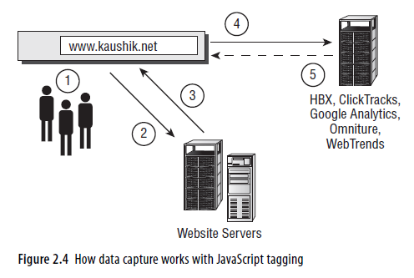
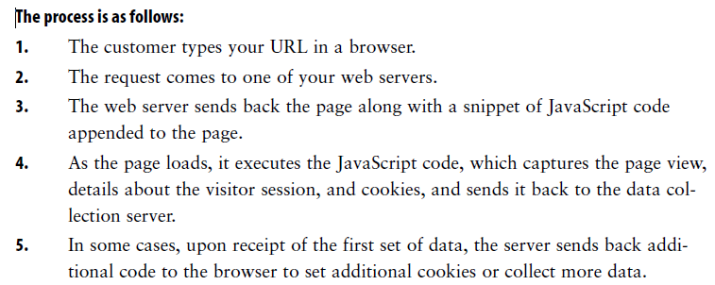

Slide 13
Benefits of Using JavaScript Tagging as Your Data Collection Mechanism
Adding a standard few lines of JavaScript code in a global site element (such as a header) can instantly tag the entire site,
If you don’t have access to your web servers, JavaScript tagging is your only choice.
Regardless of where your web page is being served from, the JavaScript tag will execute and your analytics tool will be able to collect the data.
You have a great deal of control over exactly what data is collected. You also have the ability to implement custom tags on special pages (cart, checkout, order confirmation, knowledge base articles) that allow you to capture additional data for those pages (for example, order value, quantity, product names)
Data capture becomes your vendor’s responsibility. You don’t have to trouble your IT department to set cookies to track sessions; your tool can do it now.
If you use third-party cookies (set by you or, as is usually the case, your vendor), tracking users across multiple domains becomes easier, because your third-party cookie and its identifying elements stay consistent as visitors go across multiple domains where your JavaScript tags exist.

Slide 14
Concerns about Using JavaScript Tagging as Your Primary Data Collection Mechanism
Not all website visitors have JavaScript turned on, often for privacy or other reasons.
Data collected via JavaScript tagging is divorced from other metadata
JavaScript tags collect data “browser side” and not “server side.” Some websites, rather than storing some data in cookies or URL parameters, will store data on the servers during the visitor session.
Capturing data in JavaScript tags about downloads (for example, PDFs or EXEs) is harder
If your website is already JavaScript heavy, with lots of JavaScript on the site trying to do lots of clever things, your web analytics JavaScript tag could cause conflicts.

Slide 15
Packet Sniffing
Packet sniffing technically is one of the most sophisticated ways of collecting web data
A packet sniffer can be a layer of software that is installed on the web servers and runs “on top” of the web server data layer. Alternatively, it can be a physical piece of hardware that is hooked up in your data center, and all traffic is then routed to your web server via the packet sniffer solution.

Slide 16
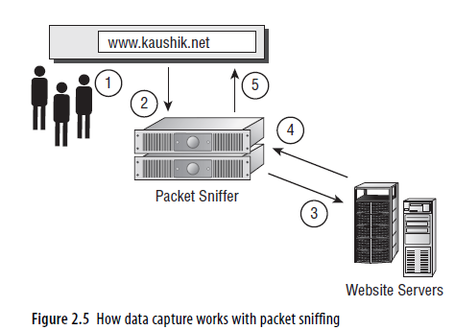
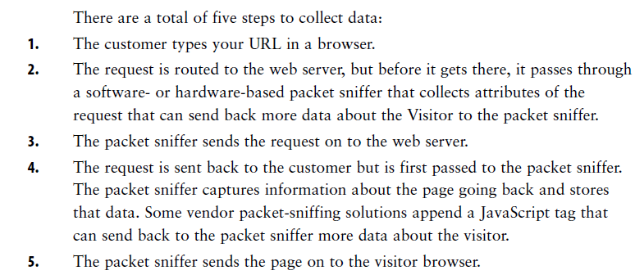

Slide 17
Benefits of Using Packet Sniffers as Your Data Collection Mechanism
Because all data passes through the packet sniffer, first it eliminates the need to use JavaScript tags for your website
Your time to market is a bit longer than with JavaScript tagging because of the reliance on IT to approve and install the additional software and hardware in the data center
You can collect lots and lots of data instantly, much more than with standard JavaScript tagging.

Slide 18
Concerns about Using Packet Sniffers as Your Data Collection Mechanism
For most companies, it is quite a struggle to make a case for and convince the IT department to add an additional layer of software on the web servers or to physically install hardware in their high-profile data centers and route all web traffic via these solutions.
you are collecting raw packets of your Internet web server traffic. This poses two important challenges: First, nontrivial amounts of configuration work with your packet-sniffing solution to parse out just the needed data from all the raw data. The second challenge is privacy.
When using most packet-sniffing solutions, you would still need JavaScript tags to truly collect all the data that you will need for optimal analysis.
Packet sniffing can get expensive if you have many web servers ,if you have web servers sitting on many networks

Slide 19
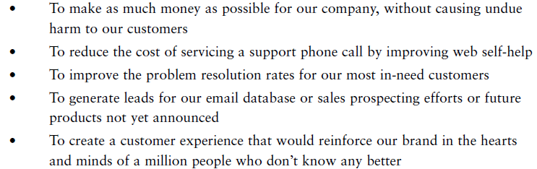
Outcomes Data
Most of the data that you obtain will be based on customer clicks
Visitors (visits, total, unique)
• Page views (individual, aggregates, averages)
• Time (overall, averages, slices)
• Referrers (counts, websites, keywords, trends)
This is why it is extremely important to think really hard about your outcomes data strategy—which should begin with the question, why does your website exist?

Slide 20
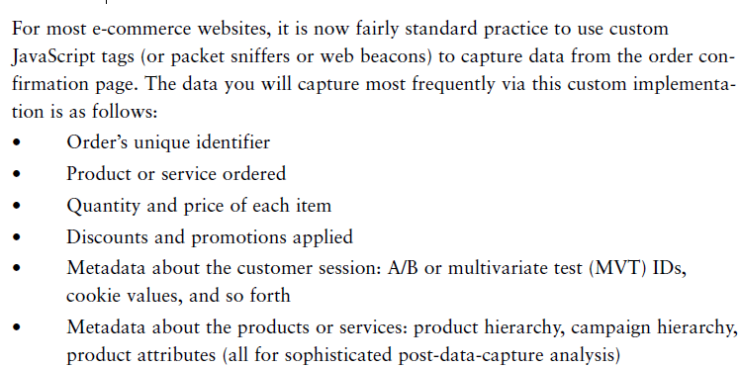
E-commerce

Slide 21
Increasingly, cornerstone of an optimal web analytics strategy is having a data warehouse environment that allows you to have more-complex data in an easy-to-report-from environment.
Data warehouses are typically very flexible when it comes to importing data from external sources
Data warehouses are typically very flexible when it comes to importing data from external sources

Slide 22
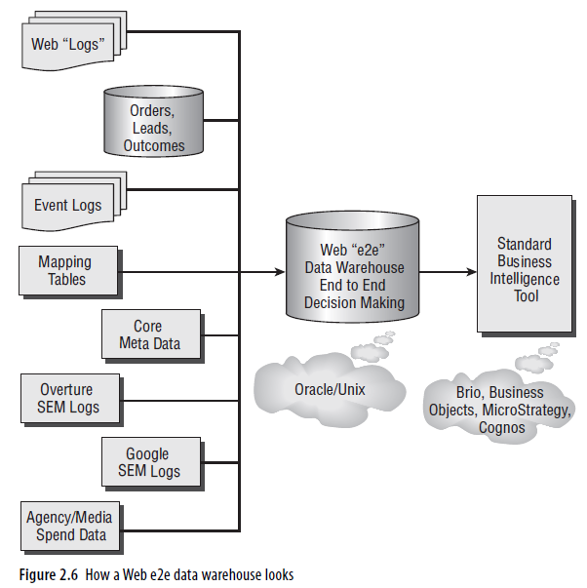

Slide 23
Competitive Data
True delight comes from knowing how you are doing vis-a-vis your competitors or the industry as a whole. This competitive intelligence is key to helping you understand your performance in the context of the greater web ecosystem
allows you to better understand whether a certain result is caused by eco-system trends or your actions (or lack thereof).
Having a focused competitive intelligence program can help you exploit market trends, build off the success of your competitors,
Help to optimize your search engine marketing program—because you know exactly what your competitor is doing
There are three main methodologies used to collect data that is then analyzed for competitive intelligence on the Web:
panel-based measurement,
ISP-based measurement,
search engine data.

Slide 24
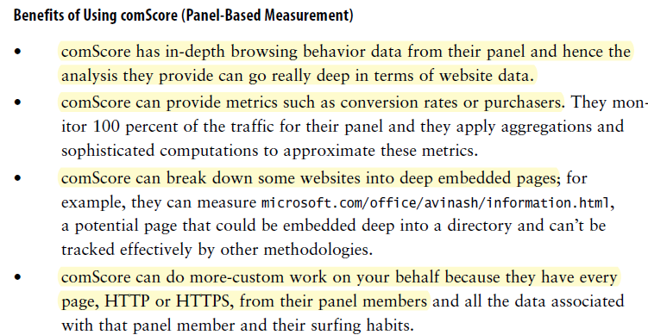
Panel-based measurement is very much inspired by traditional television Nielsen ratings systems, whereby in exchange for an incentive, the participant agrees to have their TV viewing behavior tracked.
A company called comScore NetWorks uses panel-based measurement to compile data that is used by many companies for competitive analysis

Slide 25
Concerns about Using comScore (Panel-Based) Data
Sample size could be a concern with comScore, since you are extrapolating the behavior of 200 million people
comScore monitoring software is considered invasive (sometimes spyware)
With most panel-based measurement systems, a small percentage of web users represent the general population
Recommendation
comScore is most suited for decision making in advertising

Slide 26
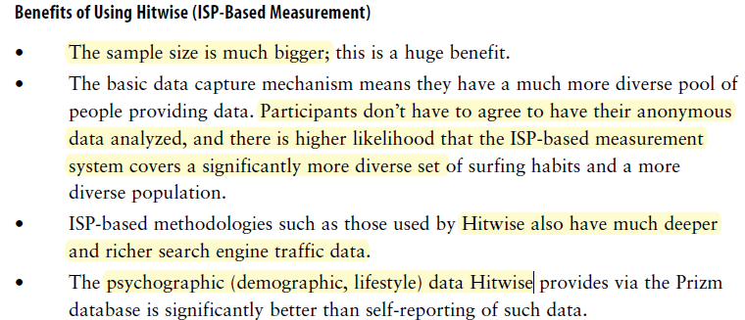
ISP-Based Measurement
The second method of collecting data for competitive analysis uses anonymous data that is captured by various Internet Service Providers (ISPs).
While all of us surf, all our data is funneling through the ISPs that we all use to connect to the Internet. Companies such as Hitwise have agreements with ISPs worldwide whereby the ISPs share the anonymous web log data collected on the ISP network with Hitwise

Slide 27
Concerns about Using Hitwise (ISP-Based Measurement)
Hitwise data offers more breadth (websites, participants, search engines, and
networks), but it does not go too deep into an individual website
Conversion rate–type metrics are best obtained from services that use panel based methodologies
Recommendation
Hitwise is most suited as a marketing tool:

Slide 28
Search Engine Data
Search engines collect massive amounts of data related to searches.
On Google Trends (www.google.com/trends), you can enter one or more search phrases and Google will indicate the total number of searches done over time for those key phrases, the number of times the phrases have appeared in stories in Google News (it also shows the news story), and the top regions, cities, and languages for the search phrases you typed in.
Benefits of Using Search Engine Data
• Access to the data and analysis is completely free.
• Because most web surfers tend to use search engines, this data represents a huge number of web users.
• Search engines are a great source of detailed data related to keyword behavior

Slide 29
Concerns about Using Search Engine Data
• The amount of analysis you can do is limited and not close to what Hitwise or comScore can offer.
• The tools are still maturing and in a beta phase.
Recommendation
Search engine data, which is free,is best suited for search engine keyword behavior and long-term trends

